Slide 1
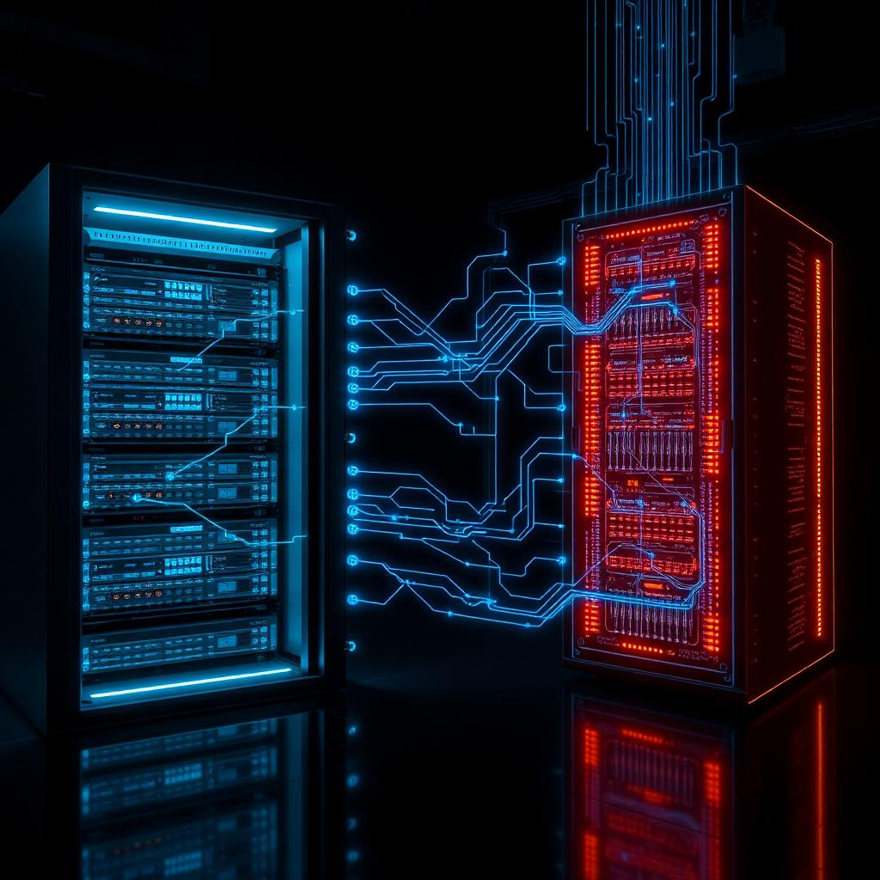
DIGITAL TWIN NETWORKS
AND THE OSI MODEL
Presented by
S HARIPRIYA
Reg No: 192412448

Slide 2
What is a Digital Twin Network?
A live virtual copy of a real network — like a mirror that updates in real time.
Uses sensors and data to reflect what's actually happening on the physical network.
Let's engineers test changes safely before applying them to the real system.
Helps predict failures, plan upgrades, and troubleshoot without downtime.

Slide 3
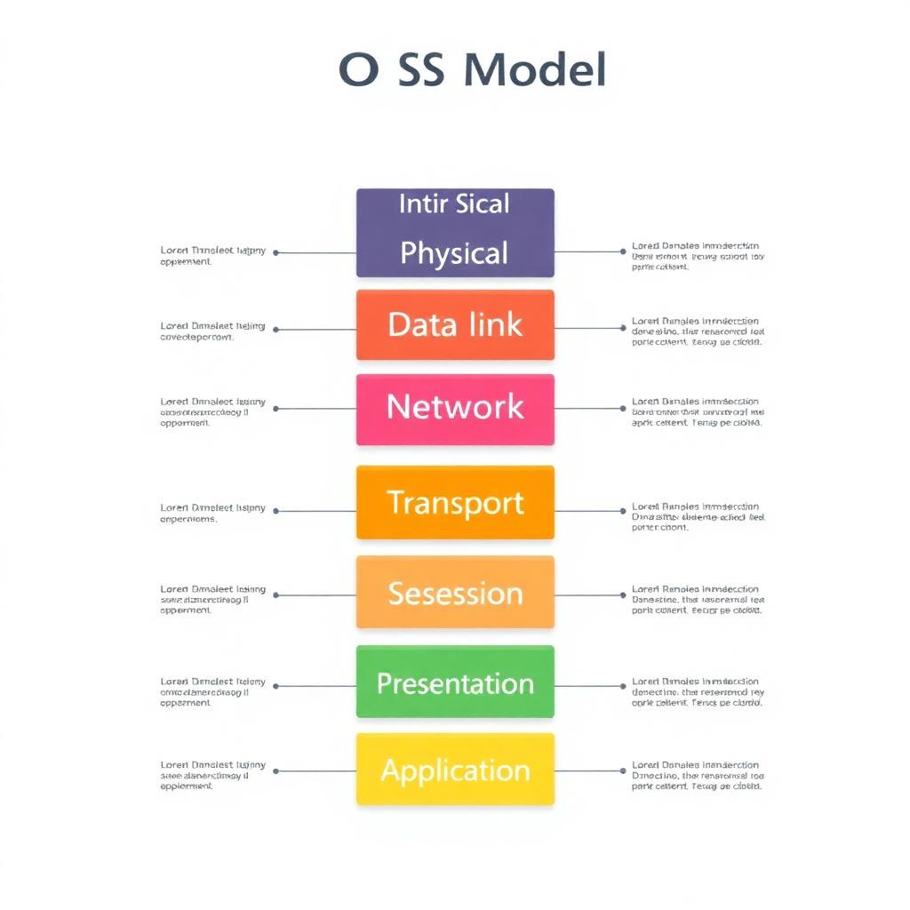
Quick Recap: The OSI Model
A 7-layer framework that explains how data travels across networks.
Physical & Data Link — cables, signals, and MAC addresses.
Network & Transport — IP routing and reliable delivery (TCP/UDP).
Session, Presentation & Application — user-facing services like web and email.
Each layer has its own job, making networks easier to design and debug.

Slide 4
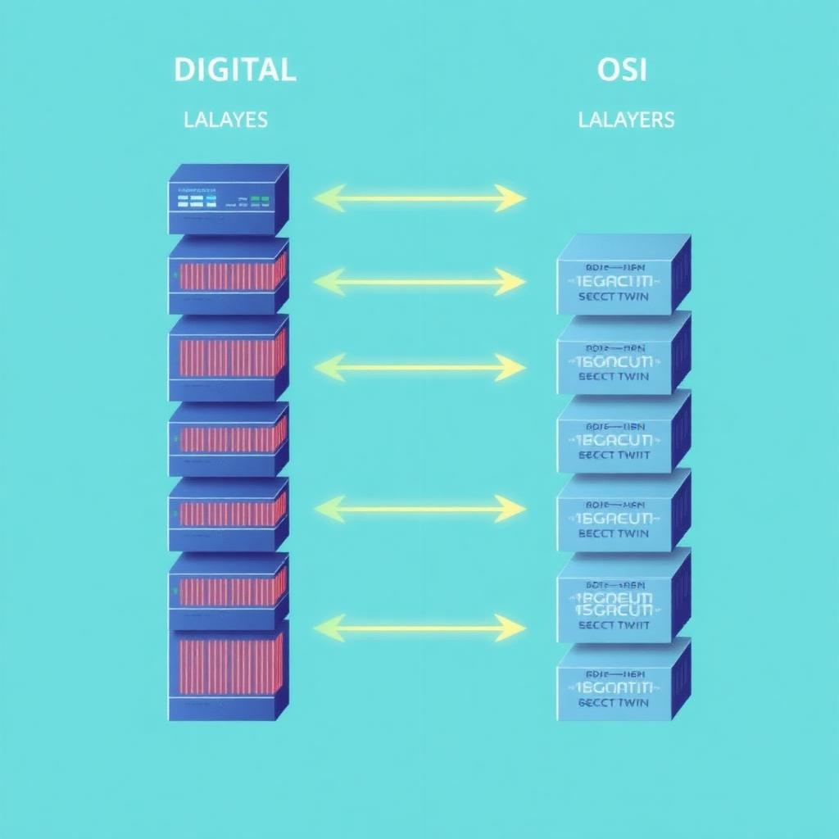
How Digital Twins Map to OSI Layers
Physical layer twin — models cables, ports, and signal quality.
Data link & network twin — simulates switches, routers, and traffic flow.
Transport twin — checks bandwidth, latency, and packet loss in real time.
Application twin — mirrors user services to test performance before rollout.
Together, they give a full-stack view of the entire network's health.

Slide 5

Benefits & Real-World Use Cases
Fewer outages — spot problems in the twin before users feel them.
Faster upgrades — test 5G, IoT, and cloud rollouts risk-free.
Smart cities — monitor traffic, power grids, and sensors from one dashboard.
Telecom operators — plan capacity and optimize routing intelligently.
The future: self-healing networks that fix themselves using AI + digital twins.
Thank You!

Slide 6
THANK YOU

